Slide 1
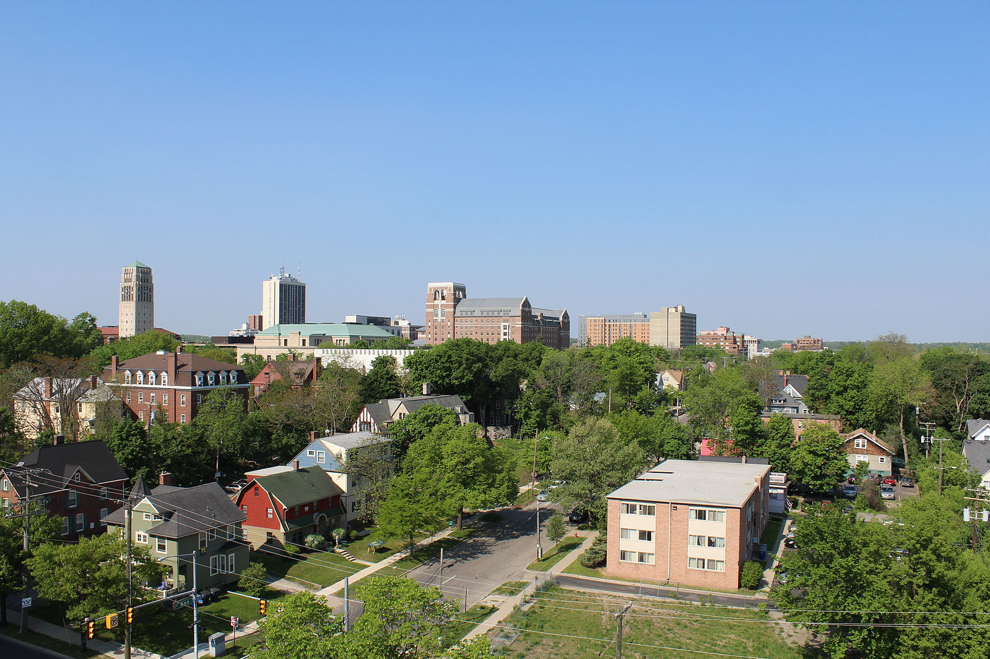
Promoting inclusive economic growth
Implications for greater Chicago
Amy Liu, Brookings Metropolitan Policy Program | @amy_liuw
July 30, 2019

Slide 2
1
2
1
2
3
3
How Chicago fares on inclusive growth
Structural dynamics complicate progress
Economic and demographic changes within Greater Washington
Why place matters to the regional economy
HQ2’s implications and what leaders in the region should do
An emerging framework for action

Slide 3
1
2
3
How Chicago fares on inclusive growth
Structural dynamics complicate progress
An emerging framework for action

Slide 4
Market demand for place has shifted over time
1
2
3
1
1
2
3
A new framework for growth
“The goal is to put a regional economy on a trajectory
of higher growth by increasing the productivity
of firms and workers in a way that
raises standards of living for all.”
- 1.5
percentage pt. decrease in tech employment share
- “Remaking Economic Development,” Brookings, 2016
Largest 100
metro average
Chicago
All occupations
All occupations
Tech occupations
Tech occupations
2016
Notes:
Place has always mattered to economy…but demands for place have shifted over time.
In 19th century, America’s cities grew to become not only centers of commerce and trade, but powerhouses of invention and industry.
Within these cities, manufacturing activities often clustered in separate enclaves depending on what they were producing and for whom. A diverse mix of consumer-serving artisans—printers, cobblers, tailors, etc.—tended to locate in CBDs, close to retailers, business offices, and large numbers of unskilled workers.
Larger-scale firms with wider markets and bigger production footprints concentrated in discrete industrial districts distinguished by product, organization of production, power source, composition of workers. A mix of worker housing, smaller producers, and local-serving shops often co-located in these districts, allowing residents and workers easy access to daily needs and activities.
Demand for place dramatically changed with the advent of automobile, as people/jobs left central cities for greener, whiter, suburban pastures.
The mid-20th century also witnessed the rise of the suburban research park. While the agricultural and industrial innovations of the past facilitated and benefited from a clustering of businesses and workers, many of the advanced, research-intensive firms of the day actually preferred the kind of physical development patterns—large footprints with ample parking—that allowed their researchers to keep their IP secret.
During the 21st century, the pendulum has been swinging back as urban attributes – walkability, density, proximity -are once again valued.

Slide 5
Every region should pursue three goals
1
2
3
GROWTH
PROSPERITY
INCLUSION
Jobs
Productivity
Employment rate
Output
Standard of Living
Median wage
Entrepreneurship
Average wage
Relative poverty rate
Header option 2
(choose one and stick to it throughout the presentation to keep consistency)

Slide 6
Greater Washington needs more growth, prosperity, and inclusion
1
2
3
Chicago has had uneven progress on growth, prosperity, & inclusion
1
2
3
GROWTH
PROSPERITY
INCLUSION
72nd
2007-2017
57th
2007-2017
28th
2007-2017
Jobs
Productivity
Employment rate
Output
Standard of Living
Median wage
Entrepreneurship
Average wage
Relative poverty rate
Source: Brookings, “Metro Monitor,” 2019

Slide 8
Greater Washington needs more growth, prosperity, and inclusion
1
2
3
Chicago has had uneven progress on growth, prosperity, & inclusion
1
2
3
Jobs
2007-2017
Output per capita
2007-2017
Median earnings
2007-2017
54th
10-year rank:
39th
10-year rank:
10-year rank:
82nd
Source: Brookings, “Metro Monitor,” 2019
Header option 2
(choose one and stick to it throughout the presentation to keep consistency)

Slide 9
Greater Washington needs more growth, prosperity, and inclusion
1
2
3
Chicago has made little progress on racial inclusion
1
2
3
Median earnings, Chicago metro area
RACIAL INCLUSION
Whites
+$1,900
Change in median earnings gap, 2007-2017
People of color
Rank: 70th of 100
Source: Brookings, “Metro Monitor,” 2019

Slide 10
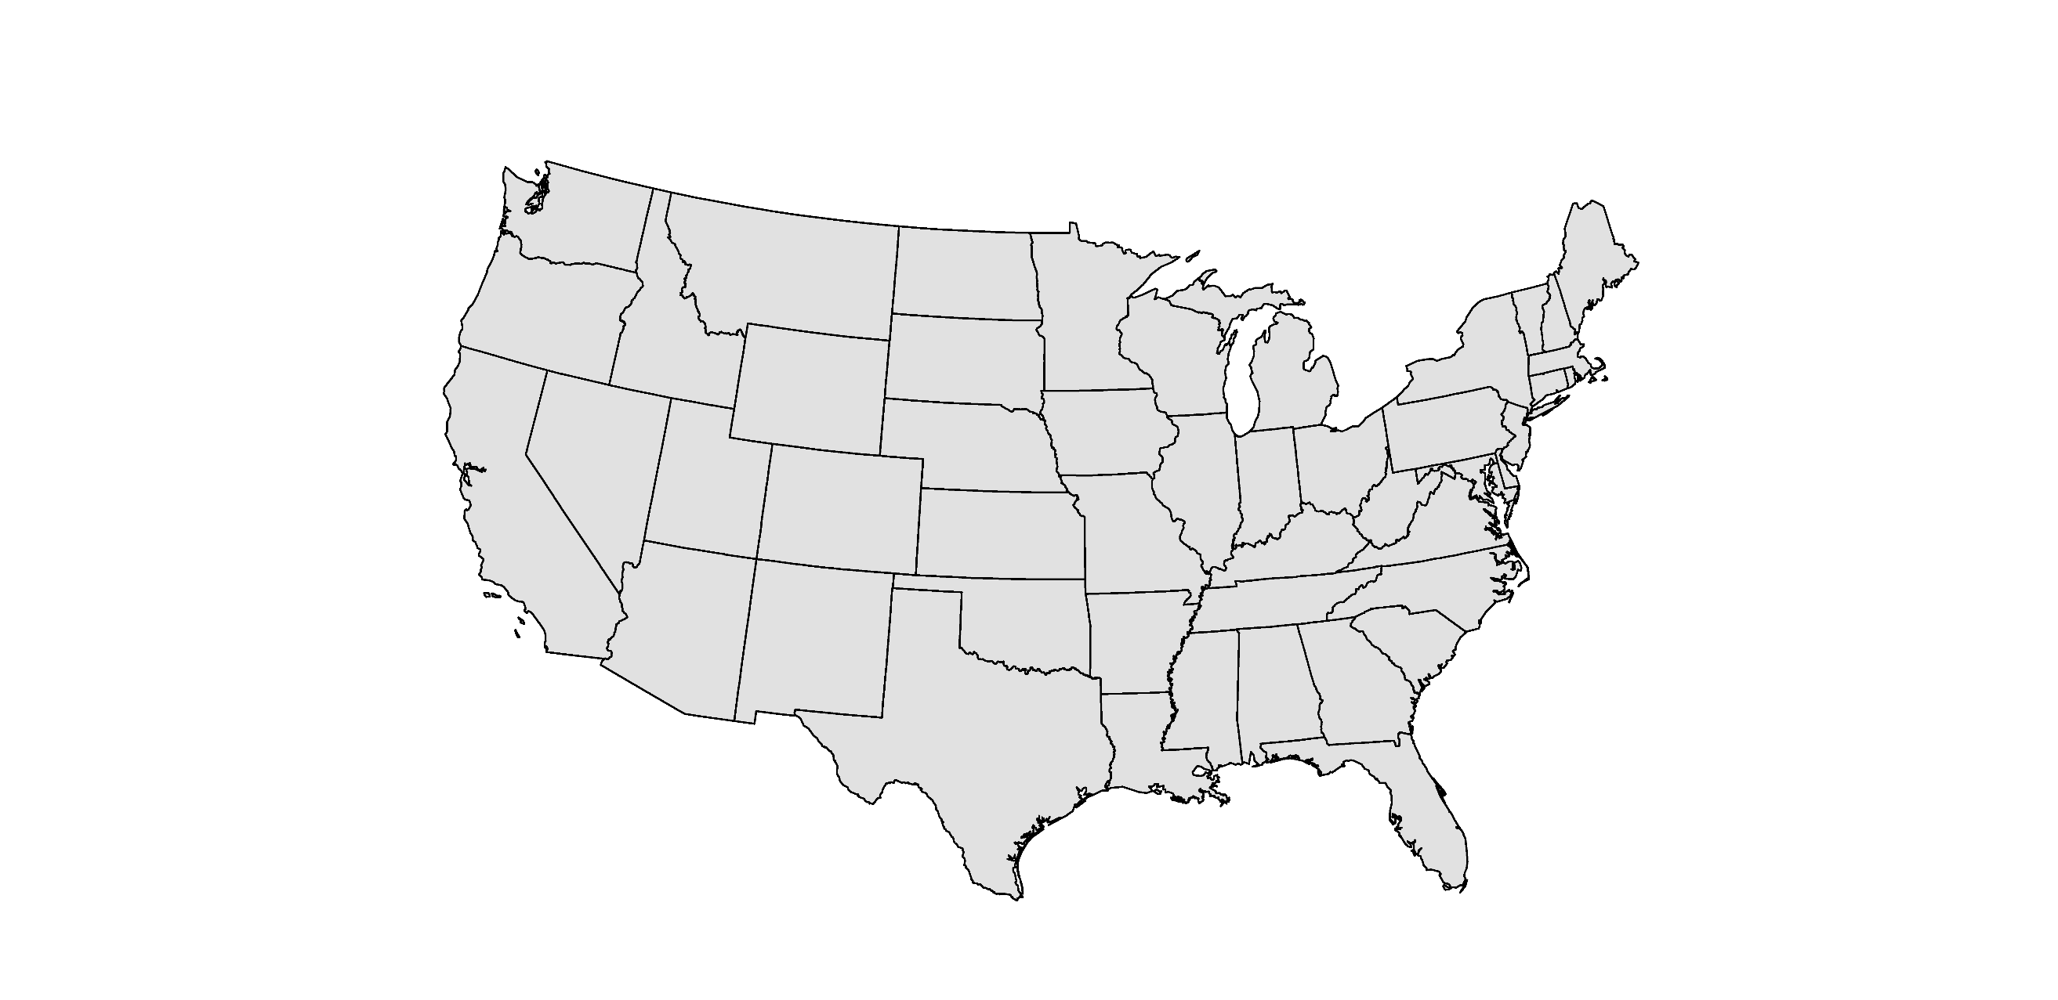
Market demand for place has shifted over time
1
2
3
Just five metro areas experienced productive, inclusive growth
1
2
3
Metro areas with gains across all growth, prosperity, inclusion, & racial inclusion indicators*, 2007 - 2017
Denver
Knoxville
- 1.5
percentage pt. decrease in tech employment share
Los Angeles
Chattanooga
El Paso
Largest 100
metro average
Source: Brookings, “Metro Monitor,” 2019 *All metro areas pictured except for Denver experienced declining rates of entrepreneurship, as did most large metros
Chicago
All occupations
All occupations
Tech occupations
Tech occupations
2016
Notes:
Place has always mattered to economy…but demands for place have shifted over time.
In 19th century, America’s cities grew to become not only centers of commerce and trade, but powerhouses of invention and industry.
Within these cities, manufacturing activities often clustered in separate enclaves depending on what they were producing and for whom. A diverse mix of consumer-serving artisans—printers, cobblers, tailors, etc.—tended to locate in CBDs, close to retailers, business offices, and large numbers of unskilled workers.
Larger-scale firms with wider markets and bigger production footprints concentrated in discrete industrial districts distinguished by product, organization of production, power source, composition of workers. A mix of worker housing, smaller producers, and local-serving shops often co-located in these districts, allowing residents and workers easy access to daily needs and activities.
Demand for place dramatically changed with the advent of automobile, as people/jobs left central cities for greener, whiter, suburban pastures.
The mid-20th century also witnessed the rise of the suburban research park. While the agricultural and industrial innovations of the past facilitated and benefited from a clustering of businesses and workers, many of the advanced, research-intensive firms of the day actually preferred the kind of physical development patterns—large footprints with ample parking—that allowed their researchers to keep their IP secret.
During the 21st century, the pendulum has been swinging back as urban attributes – walkability, density, proximity -are once again valued.

Slide 11
1
2
3
How Chicago fares on inclusive growth
Structural dynamics complicate progress
An emerging framework for action

Slide 12
Entrepreneurship is down across the United States
1
2
3
Entrepreneurs
Firm birth (startup) and death rates, United States
18%
12%
birth rate
6%
death rate
0%
1978
1983
1988
1993
1998
2003
2008
2013
2016
Source: Economic Innovation Group, 2019
Header option 2
(choose one and stick to it throughout the presentation to keep consistency)

Slide 13
Digitalization is transforming the demand for skills
1
2
3
Growth rates within auto industry occupations, 2002 - 2016
Computer network support specialists
30%
20%
Software developers, system specialists
10%
0
-10%
-20%
Foundry mold
& coremarkers
Drilling & boring
machine operations
Source: Brookings, “What GM’s layoffs reveal about the digitalization of the auto industry,” 2018

Slide 14
Automation will affect less-educated people & workers of color the most
1
2
3
Average automation potential by education level or race, 2017
Entrepreneurs
49%
47%
1 in 4
jobs in the Chicago metro area are at “high risk” of automation
44%
40%
39%
29%
Less than a bachelor’s
Bachelor’s or higher
Hispanic
Black
White
Asian & Pacific Islander
Source: Brookings, “Automation and Artificial Intelligence,” 2019

Slide 15
A shrinking share of new jobs pay middle-class wages
1
2
3
Entrepreneurs
Occupational percentile
(ranked from lowest to highest average wage)
Source: David Autor, “Polanyi’s Paradox and the shape of employment growth,” 2015
Header option 2
(choose one and stick to it throughout the presentation to keep consistency)

Slide 16
Too few jobs offer workers pathways to the middle class
1
2
3
Entrepreneurs
Cook County, 2017
Good jobs:
Pay family-supporting wage
Provide health insurance
Held by sub-B.A. workers
Good jobs
Source: Brookings, “Opportunity Industries,” 2018
Header option 2
(choose one and stick to it throughout the presentation to keep consistency)

Slide 17
Too few jobs offer workers pathways to the middle class
1
2
3
Entrepreneurs
Cook County, 2017
Promising jobs:
Low-pay / no-benefits jobs
Lead to a “good job” within 10 years
Held by sub-B.A. workers
Promising jobs
Good jobs
Source: Brookings, “Opportunity Industries,” 2018
Header option 2
(choose one and stick to it throughout the presentation to keep consistency)

Slide 18
Too few jobs offer workers pathways to the middle class
1
2
3
Entrepreneurs
Cook County, 2017
High-skill
opportunity jobs:
Meet “good job” or “promising job” criteria but…
Held by workers with a B.A. or more
High-skill opportunity jobs
Promising jobs
Good jobs
Source: Brookings, “Opportunity Industries,” 2018
Header option 2
(choose one and stick to it throughout the presentation to keep consistency)

Slide 19
Too few jobs offer workers pathways to the middle class
1
2
3
Entrepreneurs
Cook County, 2017
Other jobs:
Other jobs
High-skill opportunity jobs
Do not satisfy at least one of the criteria for good, promising, or high-skilled opportunity jobs
Promising jobs
Good jobs
Source: Brookings, “Opportunity Industries,” 2018
Header option 2
(choose one and stick to it throughout the presentation to keep consistency)

Slide 20
Some industries produce more good jobs than others
1
2
3
Concentration of good and promising jobs by industry sector, Cook County, 2017
Half
Sub-baccalaureate average
Source: Brookings, “Opportunity Industries,” 2018

Slide 21
Some industries produce more good jobs than others
1
2
3
Concentration of good and promising jobs by industry sector, Cook County, 2017
Utilities, Construction, Logistics,
Manufacturing, Government
Half
Sub-baccalaureate average
Source: Brookings, “Opportunity Industries,” 2018

Slide 22
Some industries produce more good jobs than others
1
2
3
Concentration of good and promising jobs by industry sector, Cook County, 2017
Information, Headquarters, Professional services, Health care, Finance, Education
Half
Sub-baccalaureate average
Source: Brookings, “Opportunity Industries,” 2018

Slide 23
Some industries produce more good jobs than others
1
2
3
Concentration of good and promising jobs by industry sector, Cook County, 2017
Half
Real estate, Administrative services, Retail, Hospitality
Sub-baccalaureate average
Source: Brookings, “Opportunity Industries,” 2018

Slide 24
1
2
3
How Chicago fares on inclusive growth
Structural dynamics complicate progress
An emerging framework for action

Slide 25
Three pillars of inclusive economic growth
1
2
3
Quality jobs and business dynamism
Skilled
workers
Accessible & connected places
Entrepreneurs
Header option 2
(choose one and stick to it throughout the presentation to keep consistency)

Slide 26
Market demand for place has shifted over time
1
2
3
Inclusion is a value embedded across city and regional development
1
2
3
Inclusion is a mindset, not a program
Inclusive growth
Economic inclusion performance metrics
Diversity in entrepreneurship & procurement
Youth summer jobs & mentorships
Redevelopment & access
- 1.5
percentage pt. decrease in tech employment share
Individuals
Organizations
Collaborations
Largest 100
metro average
Chicago
All occupations
All occupations
Tech occupations
Tech occupations
2016
Notes:
Place has always mattered to economy…but demands for place have shifted over time.
In 19th century, America’s cities grew to become not only centers of commerce and trade, but powerhouses of invention and industry.
Within these cities, manufacturing activities often clustered in separate enclaves depending on what they were producing and for whom. A diverse mix of consumer-serving artisans—printers, cobblers, tailors, etc.—tended to locate in CBDs, close to retailers, business offices, and large numbers of unskilled workers.
Larger-scale firms with wider markets and bigger production footprints concentrated in discrete industrial districts distinguished by product, organization of production, power source, composition of workers. A mix of worker housing, smaller producers, and local-serving shops often co-located in these districts, allowing residents and workers easy access to daily needs and activities.
Demand for place dramatically changed with the advent of automobile, as people/jobs left central cities for greener, whiter, suburban pastures.
The mid-20th century also witnessed the rise of the suburban research park. While the agricultural and industrial innovations of the past facilitated and benefited from a clustering of businesses and workers, many of the advanced, research-intensive firms of the day actually preferred the kind of physical development patterns—large footprints with ample parking—that allowed their researchers to keep their IP secret.
During the 21st century, the pendulum has been swinging back as urban attributes – walkability, density, proximity -are once again valued.

Slide 27
Market demand for place has shifted over time
1
2
3
EDOs are leading the transition to inclusive economic growth
1
2
3
Central New York
CenterState CEO
Vice President & team for economic inclusion
Employer partnerships for low-income workers
Neighborhood revitalization
- 1.5
percentage pt. decrease in tech employment share
Indianapolis
CICP & Indy Chamber
San Diego
San Diego
Regional EDC
Entrepreneurship for ex-offenders
Inclusive incentives
Community revitalization
Building a strong local talent pipeline
Equipping small businesses to compete
Addressing the affordability crisis
Largest 100
metro average
Chicago
All occupations
All occupations
Tech occupations
Tech occupations
2016
Notes:
Place has always mattered to economy…but demands for place have shifted over time.
In 19th century, America’s cities grew to become not only centers of commerce and trade, but powerhouses of invention and industry.
Within these cities, manufacturing activities often clustered in separate enclaves depending on what they were producing and for whom. A diverse mix of consumer-serving artisans—printers, cobblers, tailors, etc.—tended to locate in CBDs, close to retailers, business offices, and large numbers of unskilled workers.
Larger-scale firms with wider markets and bigger production footprints concentrated in discrete industrial districts distinguished by product, organization of production, power source, composition of workers. A mix of worker housing, smaller producers, and local-serving shops often co-located in these districts, allowing residents and workers easy access to daily needs and activities.
Demand for place dramatically changed with the advent of automobile, as people/jobs left central cities for greener, whiter, suburban pastures.
The mid-20th century also witnessed the rise of the suburban research park. While the agricultural and industrial innovations of the past facilitated and benefited from a clustering of businesses and workers, many of the advanced, research-intensive firms of the day actually preferred the kind of physical development patterns—large footprints with ample parking—that allowed their researchers to keep their IP secret.
During the 21st century, the pendulum has been swinging back as urban attributes – walkability, density, proximity -are once again valued.

Slide 28
Market demand for place has shifted over time
1
2
3
Minneapolis-Saint Paul is adopting a new approach to growth
1
2
3
Minneapolis-Saint Paul
Regional vision
The Greater MSP region leads the world in inclusive economic growth by welcoming all, empowering talent, and igniting innovation
Partnership mission
The Greater MSP partnership will accelerate regional competitiveness and inclusive economic growth through job creation, capital investment, and execution of strategic initiatives
- 1.5
percentage pt. decrease in tech employment share
Largest 100
metro average
Chicago
All occupations
All occupations
Tech occupations
Tech occupations
2016
Notes:
Place has always mattered to economy…but demands for place have shifted over time.
In 19th century, America’s cities grew to become not only centers of commerce and trade, but powerhouses of invention and industry.
Within these cities, manufacturing activities often clustered in separate enclaves depending on what they were producing and for whom. A diverse mix of consumer-serving artisans—printers, cobblers, tailors, etc.—tended to locate in CBDs, close to retailers, business offices, and large numbers of unskilled workers.
Larger-scale firms with wider markets and bigger production footprints concentrated in discrete industrial districts distinguished by product, organization of production, power source, composition of workers. A mix of worker housing, smaller producers, and local-serving shops often co-located in these districts, allowing residents and workers easy access to daily needs and activities.
Demand for place dramatically changed with the advent of automobile, as people/jobs left central cities for greener, whiter, suburban pastures.
The mid-20th century also witnessed the rise of the suburban research park. While the agricultural and industrial innovations of the past facilitated and benefited from a clustering of businesses and workers, many of the advanced, research-intensive firms of the day actually preferred the kind of physical development patterns—large footprints with ample parking—that allowed their researchers to keep their IP secret.
During the 21st century, the pendulum has been swinging back as urban attributes – walkability, density, proximity -are once again valued.

Slide 29
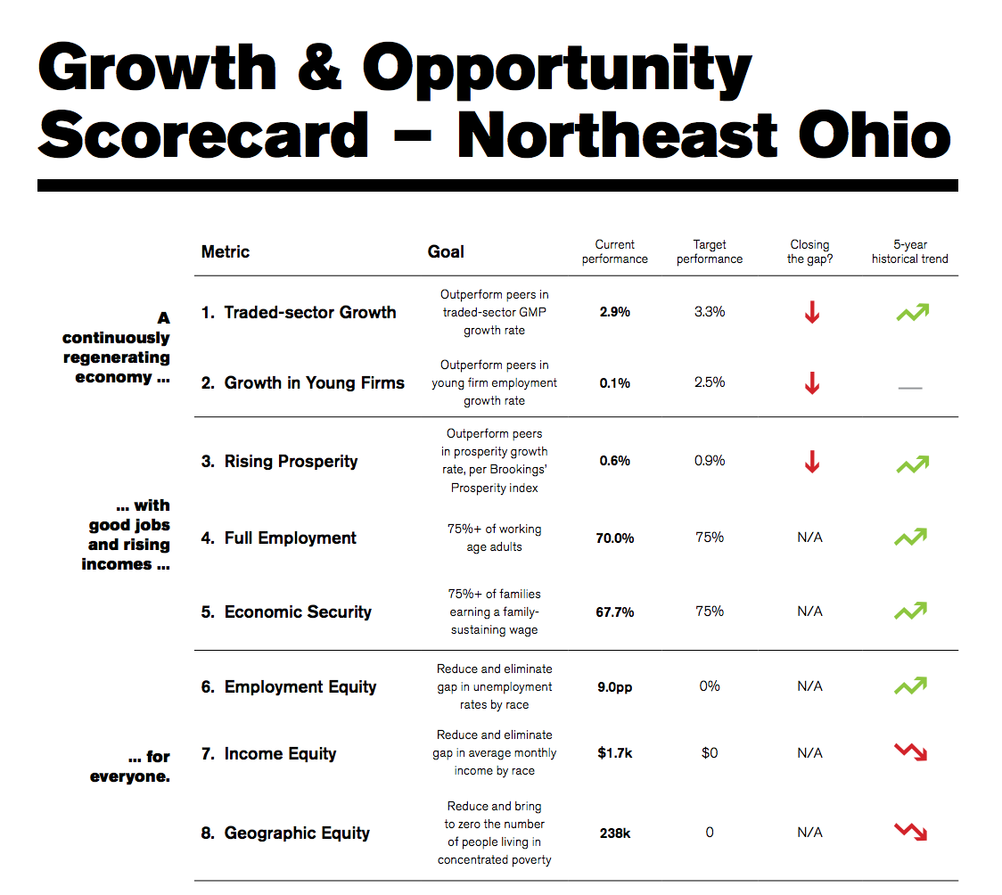
Market demand for place has shifted over time
1
2
3
Northeast Ohio has adopted new metrics to reflect its vision
1
2
3
Northeast Ohio
The Fund for our
Economic Future
A continuously regenerating economy…
Traded sector growth
Growth in young firms
Rising prosperity
…with good
jobs and rising incomes…
- 1.5
percentage pt. decrease in tech employment share
Full employment
Economic security
Employment equity
…for everyone.
Income equity
Geographic equity
Largest 100
metro average
Chicago
All occupations
All occupations
Tech occupations
Tech occupations
2016
Notes:
Place has always mattered to economy…but demands for place have shifted over time.
In 19th century, America’s cities grew to become not only centers of commerce and trade, but powerhouses of invention and industry.
Within these cities, manufacturing activities often clustered in separate enclaves depending on what they were producing and for whom. A diverse mix of consumer-serving artisans—printers, cobblers, tailors, etc.—tended to locate in CBDs, close to retailers, business offices, and large numbers of unskilled workers.
Larger-scale firms with wider markets and bigger production footprints concentrated in discrete industrial districts distinguished by product, organization of production, power source, composition of workers. A mix of worker housing, smaller producers, and local-serving shops often co-located in these districts, allowing residents and workers easy access to daily needs and activities.
Demand for place dramatically changed with the advent of automobile, as people/jobs left central cities for greener, whiter, suburban pastures.
The mid-20th century also witnessed the rise of the suburban research park. While the agricultural and industrial innovations of the past facilitated and benefited from a clustering of businesses and workers, many of the advanced, research-intensive firms of the day actually preferred the kind of physical development patterns—large footprints with ample parking—that allowed their researchers to keep their IP secret.
During the 21st century, the pendulum has been swinging back as urban attributes – walkability, density, proximity -are once again valued.

Slide 30
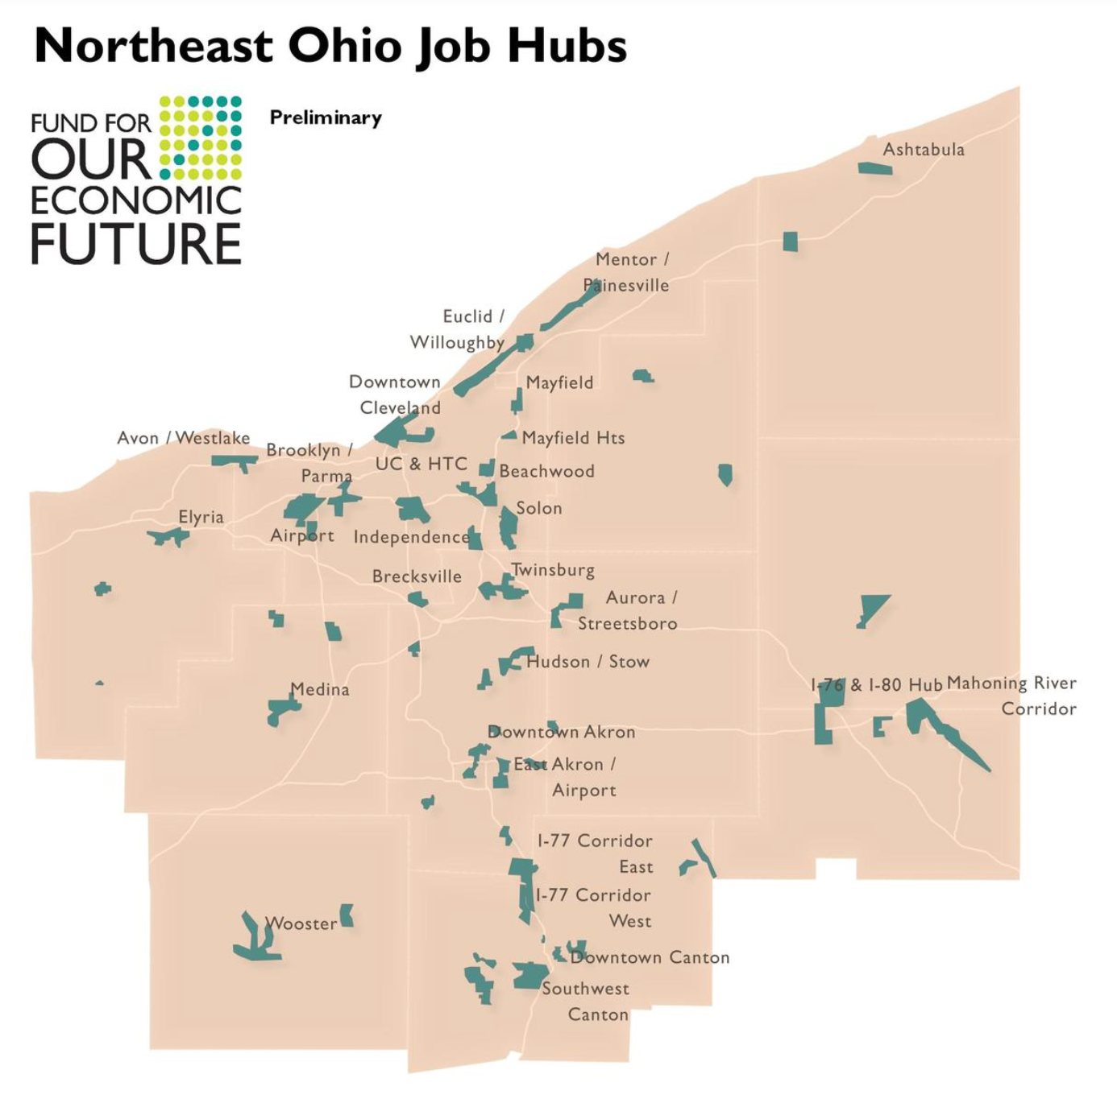
Market demand for place has shifted over time
1
2
3
Northeast Ohio is aligning transportation and community investments around job hubs
1
2
3
Northeast Ohio
The Fund for our
Economic Future
- 1.5
percentage pt. decrease in tech employment share
Traded-sector employment
Infrastructure connectivity
Placemaking and amenities
Largest 100
metro average
Chicago
All occupations
All occupations
Tech occupations
Tech occupations
2016
Notes:
Place has always mattered to economy…but demands for place have shifted over time.
In 19th century, America’s cities grew to become not only centers of commerce and trade, but powerhouses of invention and industry.
Within these cities, manufacturing activities often clustered in separate enclaves depending on what they were producing and for whom. A diverse mix of consumer-serving artisans—printers, cobblers, tailors, etc.—tended to locate in CBDs, close to retailers, business offices, and large numbers of unskilled workers.
Larger-scale firms with wider markets and bigger production footprints concentrated in discrete industrial districts distinguished by product, organization of production, power source, composition of workers. A mix of worker housing, smaller producers, and local-serving shops often co-located in these districts, allowing residents and workers easy access to daily needs and activities.
Demand for place dramatically changed with the advent of automobile, as people/jobs left central cities for greener, whiter, suburban pastures.
The mid-20th century also witnessed the rise of the suburban research park. While the agricultural and industrial innovations of the past facilitated and benefited from a clustering of businesses and workers, many of the advanced, research-intensive firms of the day actually preferred the kind of physical development patterns—large footprints with ample parking—that allowed their researchers to keep their IP secret.
During the 21st century, the pendulum has been swinging back as urban attributes – walkability, density, proximity -are once again valued.

Slide 31
Market demand for place has shifted over time
1
2
3
Amazon has signaled what the modern economy values
1
2
3
TECHNICAL
TALENT
“Include information on your K-12 education programs related to computer science.”
SUSTAINABLE PLACEMAKING
GLOBALLY CONNECTED INFRASTRUCTURE
DIVERSITY
“Sidewalks, bike lanes, trams, metro, bus, light rail, train…”
“…energy-efficient lighting… as well as public plazas and pockets of green space.”
- 1.5
percentage pt. decrease in tech employment share
“Proximity to an international airport and major highways … optimal fiber connectivity is paramount.”
“This project requires … the presence and support of a diverse population.”
Largest 100
metro average
Chicago
All occupations
All occupations
Tech occupations
Tech occupations
2016
Notes:
Place has always mattered to economy…but demands for place have shifted over time.
In 19th century, America’s cities grew to become not only centers of commerce and trade, but powerhouses of invention and industry.
Within these cities, manufacturing activities often clustered in separate enclaves depending on what they were producing and for whom. A diverse mix of consumer-serving artisans—printers, cobblers, tailors, etc.—tended to locate in CBDs, close to retailers, business offices, and large numbers of unskilled workers.
Larger-scale firms with wider markets and bigger production footprints concentrated in discrete industrial districts distinguished by product, organization of production, power source, composition of workers. A mix of worker housing, smaller producers, and local-serving shops often co-located in these districts, allowing residents and workers easy access to daily needs and activities.
Demand for place dramatically changed with the advent of automobile, as people/jobs left central cities for greener, whiter, suburban pastures.
The mid-20th century also witnessed the rise of the suburban research park. While the agricultural and industrial innovations of the past facilitated and benefited from a clustering of businesses and workers, many of the advanced, research-intensive firms of the day actually preferred the kind of physical development patterns—large footprints with ample parking—that allowed their researchers to keep their IP secret.
During the 21st century, the pendulum has been swinging back as urban attributes – walkability, density, proximity -are once again valued.

Slide 32
Promoting inclusive economic growth
Implications for greater Chicago
Amy Liu, Brookings Metropolitan Policy Program | @amy_liuw
July 30, 2019

