Slide 1
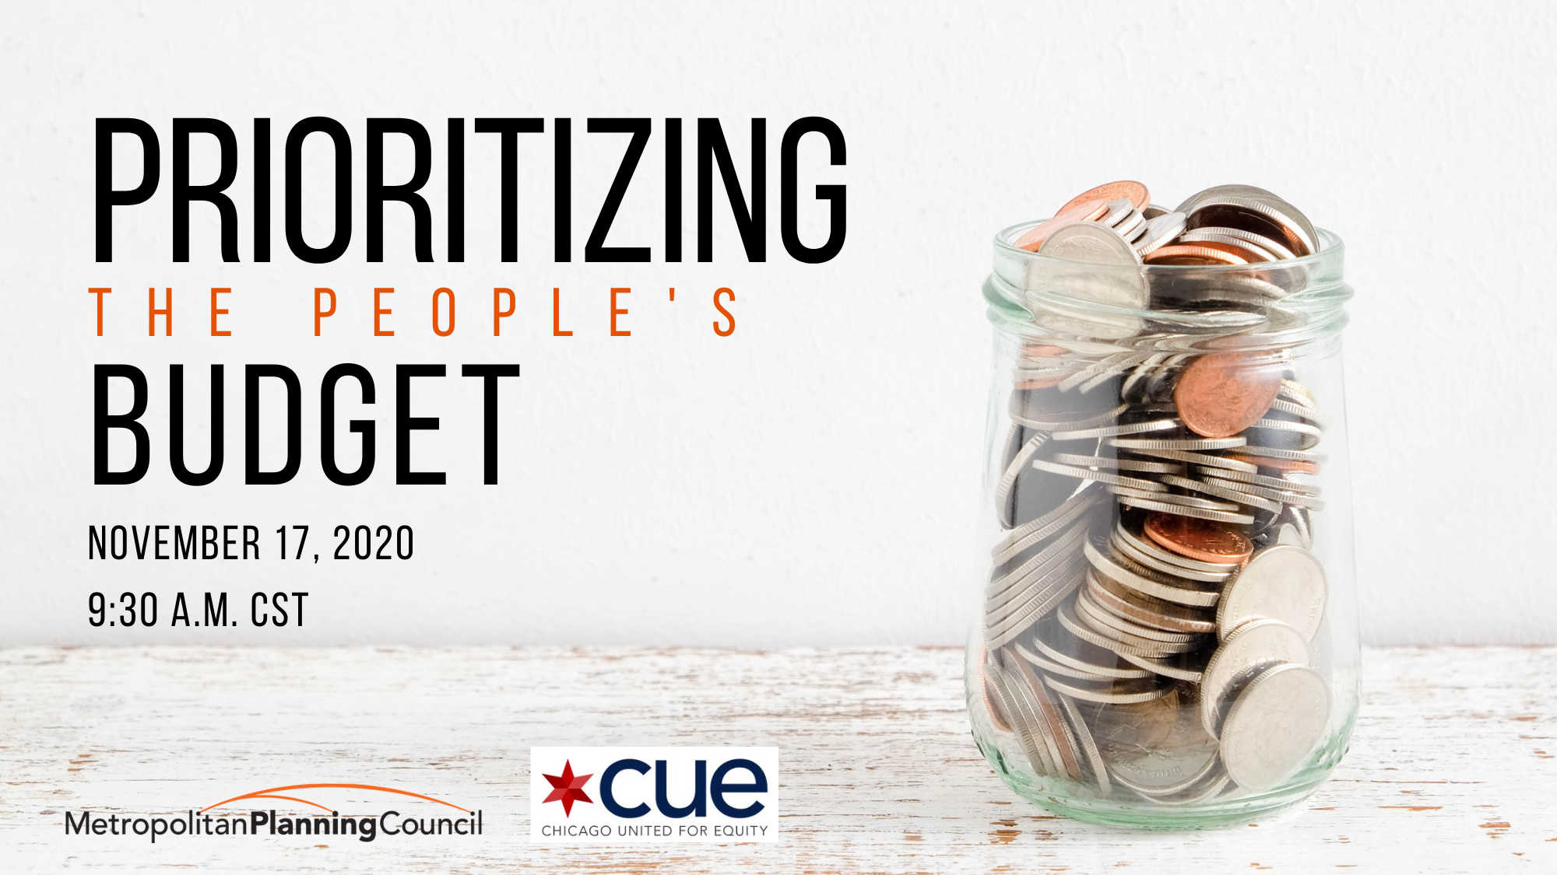

Metroplanning.org | #PrioritizingPeoplesBudget

Slide 2


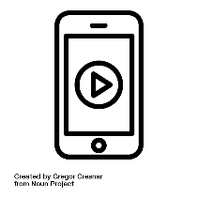
Housekeeping
Use the Q&A function only to submit questions not Chat
The webinar is being recorded
The presentation slides and recording will be emailed after the event
Metroplanning.org | #PrioritizingPeoplesBudget

Slide 3

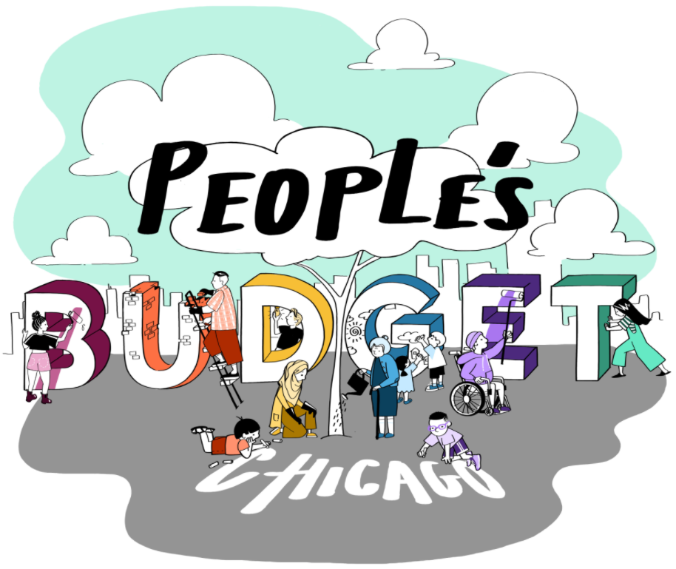
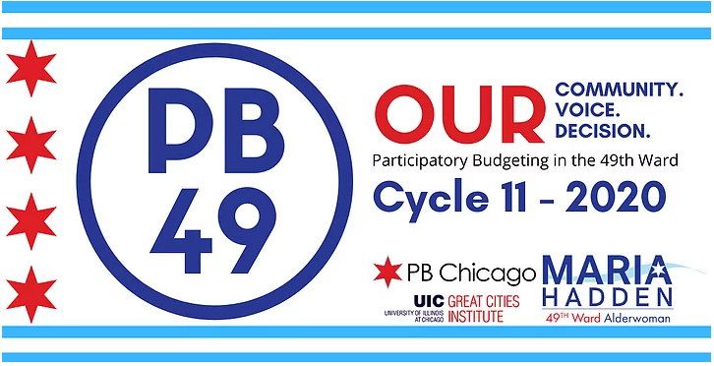
Engaging community

Slide 4
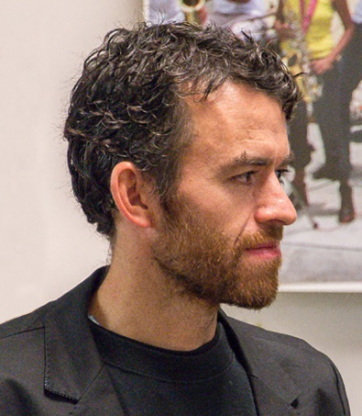
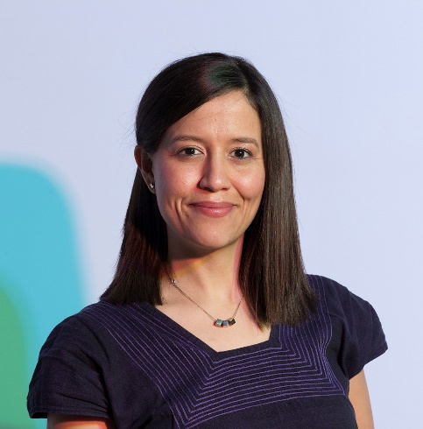
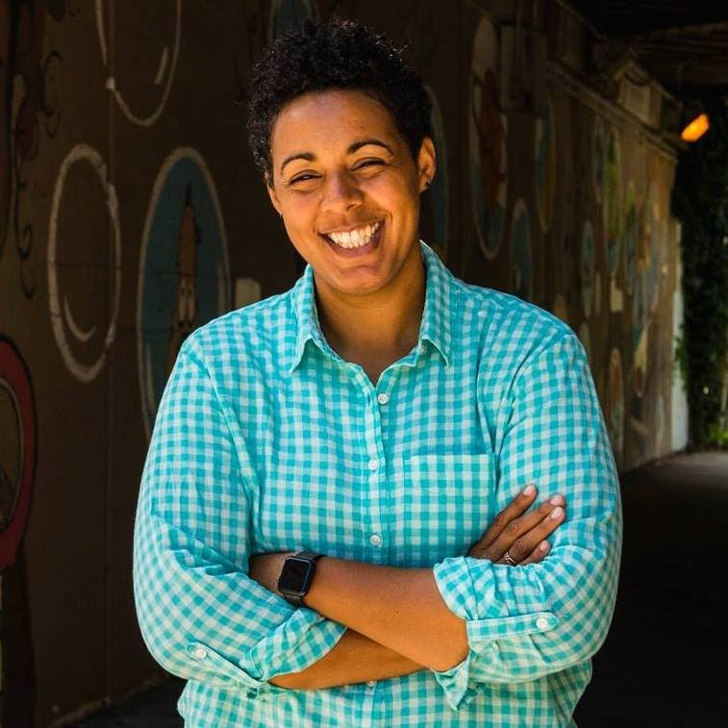
Panel
Iván Arenas, Associate Director Institute for Research on Race and Public Policy, UIC
Iván is an Associate Director at IRRPP which supports research that aims to increase society’s understanding of the root causes of racial and ethnic inequality and create research-based policy solutions. Trained as an anthropologist and architect, his research focuses on how social movements use creative art practices to establish solidarities beyond the state. Iván is active as a member of Chicago Torture Justice Memorials, CUE, the Pilsen Housing Cooperative, and the Chicago ACT Collective.
Paola Aguirre, Founder
Borderless Studio
Paola is an urban designer and founder of BORDERLESS, Chicago-based collaborative city design and research practice. Paola focuses on multidisciplinary exchange, city systems integration and participatory civic processes focused on social equity by leveraging her experience working with public, civic and private organizations in Mexico and the United States. Also an educator, Paola has taught at Sam Fox School of Design at Washington University, and the School of the Art Institute of Chicago. Paola is currently a Senior Fellow at CUE.
Maria Hadden, Alderwomen
49th Ward
Maria has been a leader in the 49th Ward through advocacy, art, and her work with Participatory Budgeting in Chicago. Before becoming Alderwoman, Maria was the Executive Director of Our City Our Voice, a national nonprofit organization she founded to enable communities and government across the country to redesign democracy for more empowered and equitable participation. Her expertise in public participation is grounded in grassroots organizing efforts for social change.

Slide 5
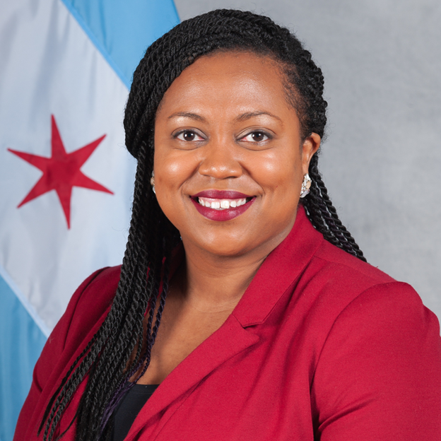
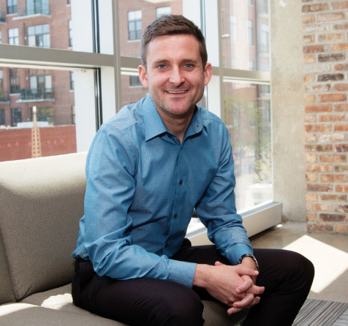
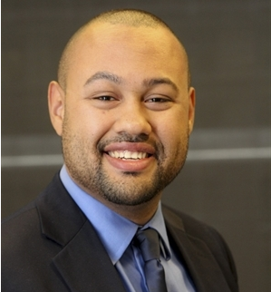
Panel
Candace Moore, Chief Equity Officer, Office of the Mayor, City of Chicago
Candace leads the Office of Equity and Racial Justice to advance policies and practices that promote equitable outcomes across city services and resources. Prior to her current role, Candace was an advocate for educational equity at the Chicago Lawyers’ Committee for Civil Rights, focused on addressing disparate school discipline and barriers to enrollment for students throughout Chicago and its surrounding communities. Candace believes that it is imperative to work in partnership with community-based advocates and institutional policy makers to create equity-based change.
JD Van Slyke, First Deputy of Community Engagement, Office of the Mayor, City of Chicago
J.D. connects residents with the Mayor and her team to advance policies related to the budget, neighborhood development, youth, water equity, LGBTQ+ communities, and bending the COVID-19 curve in Chicago. Prior to joining the Mayor’s Office, J.D. served at a variety of social impact organizations including an LGBTQ+ community center, a mentoring program for students in the middle grades, and a nonprofit to help immigrants and refugees restart their careers in the U.S.
Adam Slade, Effective Government Consultant, Metropolitan Planning Council
Adam is an effective government consultant, supporting MPC’s work to support municipal capacity building activities. He is focused on issues of racial equity in public policy, government process improvement, and budget and financial policy formulation. Prior to joining MPC, Adam has worked as a consultant for a variety of governments, including city, county, and state government organizations during their business process analysis and transformation activities. Adam is also a PhD candidate in the Dept of Public Administration at the University of Illinois at Chicago and a CUE Senior Fellow.

Slide 6
2021 Budget Engagement
Office of Mayor Lori E. Lightfoot

Slide 7
Budget Engagements
2021 Budget Survey
Budget Ambassadors
Community Round Tables
Virtual Engagements
Mayor’s Office and Office of Budget and Management

Slide 8
Survey
Survey Responses Compared to Population
City Area | Percent of Survey Responses | Percent of Population
North | 45% | 24.6%
North West | 15% | 17.2%
Loop | 10% | 6.9%
South | 9% | 24.0%
South West | 8% | 17.5%
West | 4% | 9.8%
Over 38,000 responses

Slide 9
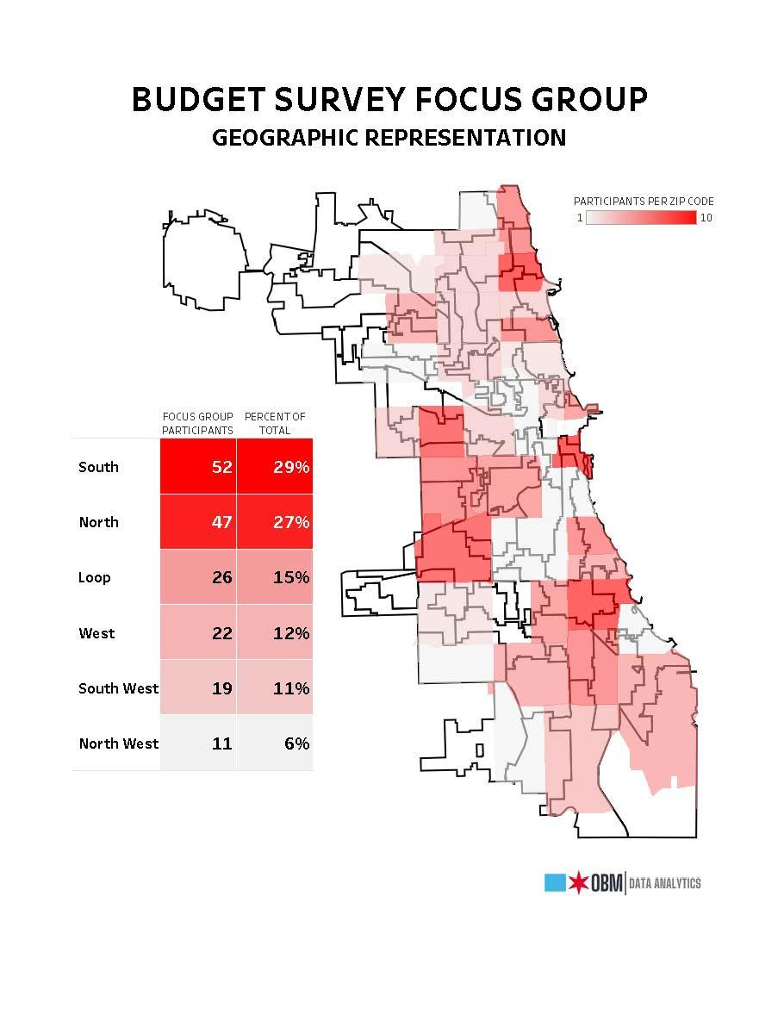
Budget Ambassadors
and Community Round Tables
141 Budget Ambassador Sign Ups
52 Budget Ambassadors hosted round tables
66 total round tables
722 testimonies

Slide 10
Virtual Engagements
Monday, 8/31: State of the Budget with Susie Park, Budget Director, Jennie Bennett, Chief Financial Officer and Alderman Pat Dowell, Chairman of the City Council Committee on Budget and Government Operations
Tuesday, 9/1: Public Safety with Susan Lee, Deputy Mayor of Public Safety, Susie Park, Budget Director
Wednesday, 9/2: Human Services with First Deputy Commissioner Brandie Knazze, Department of Family and Support Services; Dr. Allison Arwady, Department of Public Health; and Commissioner Rachel Arfa, Mayor’s Office for People with Disabilities, Susie Park, Budget Director
Thursday, 9/3: Infrastructure with Commissioner Randy Conner, Department of Water Management; Commissioner John Tully, Department of Streets and Sanitation; and Commissioner Gia Biagi, Department of Transportation, Susie Park, Budget Director
Friday, 9/4: Neighborhood and Economic Development with Commissioner Maurice Cox, Department of Planning and Development; Commissioner Marisa Novara, Department of Housing; and Commissioner Rosa Escareno, Department of Business Affairs and Consumer Protection, Susie Park, Budget Director
Wednesday, 9/30 State of the Budget with Mayor Lori Lightfoot

Slide 11
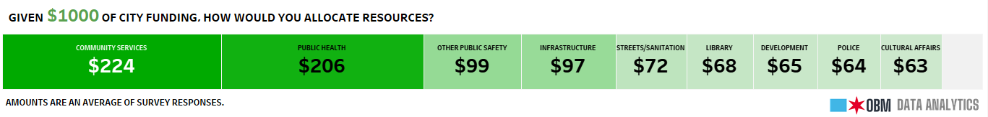
Findings
Public Health and Community Services were consistently ranked as the highest priority for City services
Respondents expressed strong support for violence prevention, mental health, homeless supports, and youth services
Many participants elected to reallocate money away from police services and expressed concern about the amount dedicated to CPD’s budget
A large number or respondents expressed a desire to invest in more resources for neighborhoods

Slide 12
Findings
Find complete results from 2021 budet engagements at:
www.chicago.gov/2021budget

Slide 13
Results
$7 million for economic recovery from the pandemic
An additional $5.25 million in violence prevention, bringing the total Corporate violence prevention investment to $16.5 million for 2021
Sustaining the additional $10 million investment in affordable housing and homelessness made in 2020
Adding $2 million for the Renew Woodlawn initiatives that support the Woodlawn Housing Ordinance passed in 2020
An additional $1.7 million in youth investments, bringing the total investment to $36.4 million for 2021

Slide 14
Thank You.

Slide 15
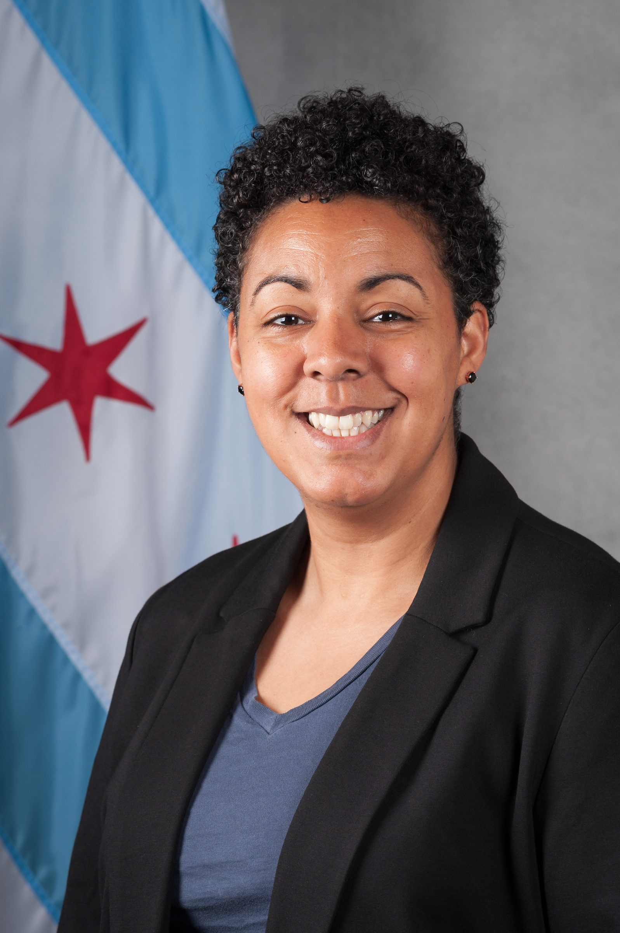
Participatory Budgeting in the 49th Ward

Slide 16
Participatory Budgeting
1989 in Porto Alegre, Brazil
2009 - First U.S. experience in Chicago’s 49th Ward
Used in more than 2,500 cities around the world
Metroplanning.org | #PrioritizingPeoplesBudget

Slide 17
Lessons Learned
Can engage historically marginalized residents
Builds civic knowledge and trust in government
Empowers residents to engage beyond PB
Metroplanning.org | #PrioritizingPeoplesBudget

Slide 18
Lessons Learned
Easy to replicate systemic issues if you don’t work to avoid them
Budget processes within government can block progress
Relying on elected officials to implement leads to inconsistencies
Metroplanning.org | #PrioritizingPeoplesBudget

Slide 19
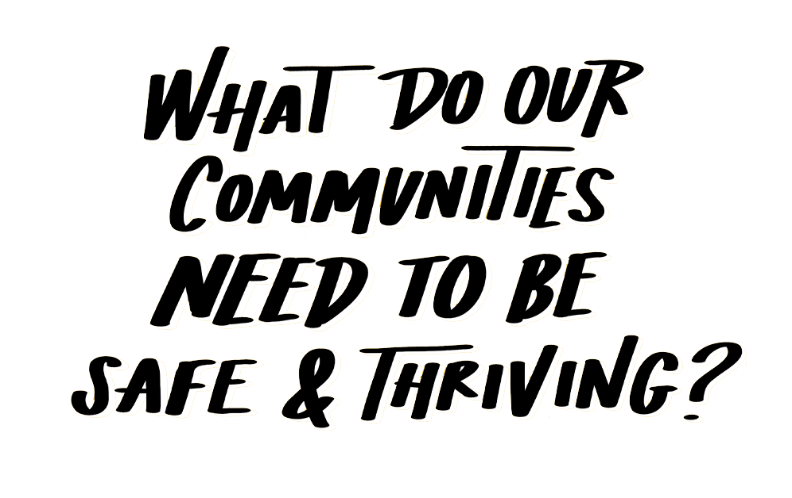
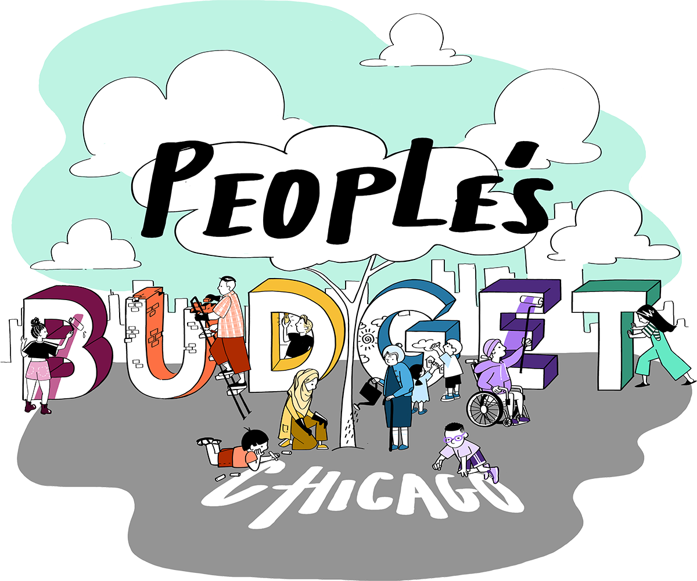

Slide 20
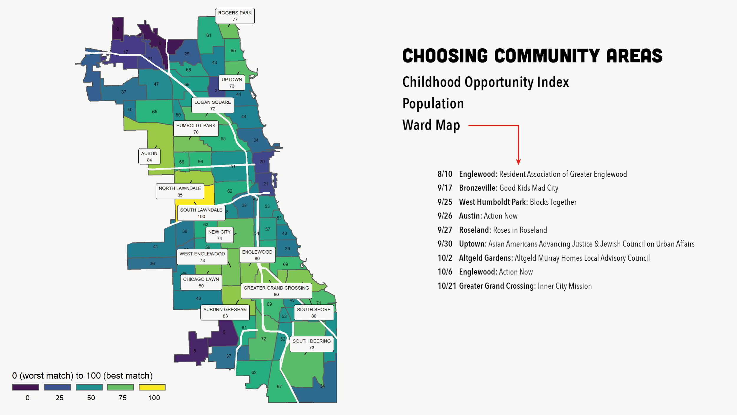

Slide 21
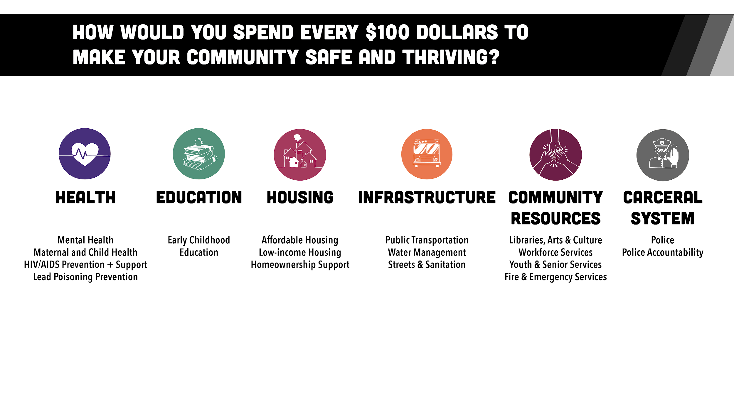
Notes:
When we asked people to vote on the people’s budget, this is the breakdown of the six categories that we asked people to vote on. You may note that the education category only includes Early Childhood Education because Chicago Public Schools is not funded by our city budget process. Likewise, CHA as a sister agency is not included in the Housing budget.

Slide 22
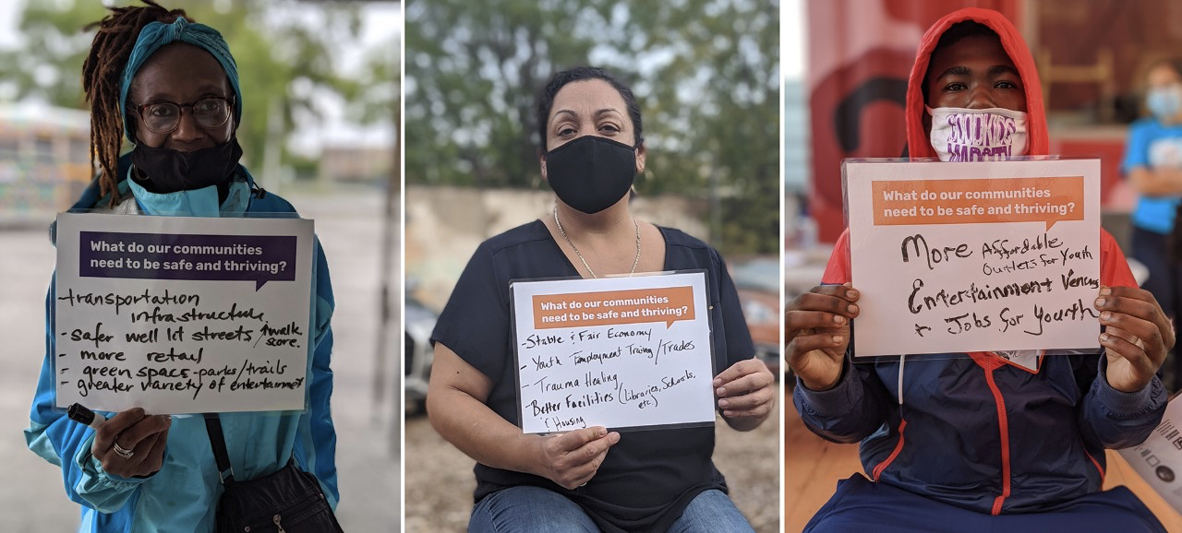
What does your community need to be safe and thriving?
Notes:
***Phases 2 & 3 must be considered and evaluated after Phase 1 progress is measured.
#englewood
#westhumboldtpark
#bronzeville

Slide 23
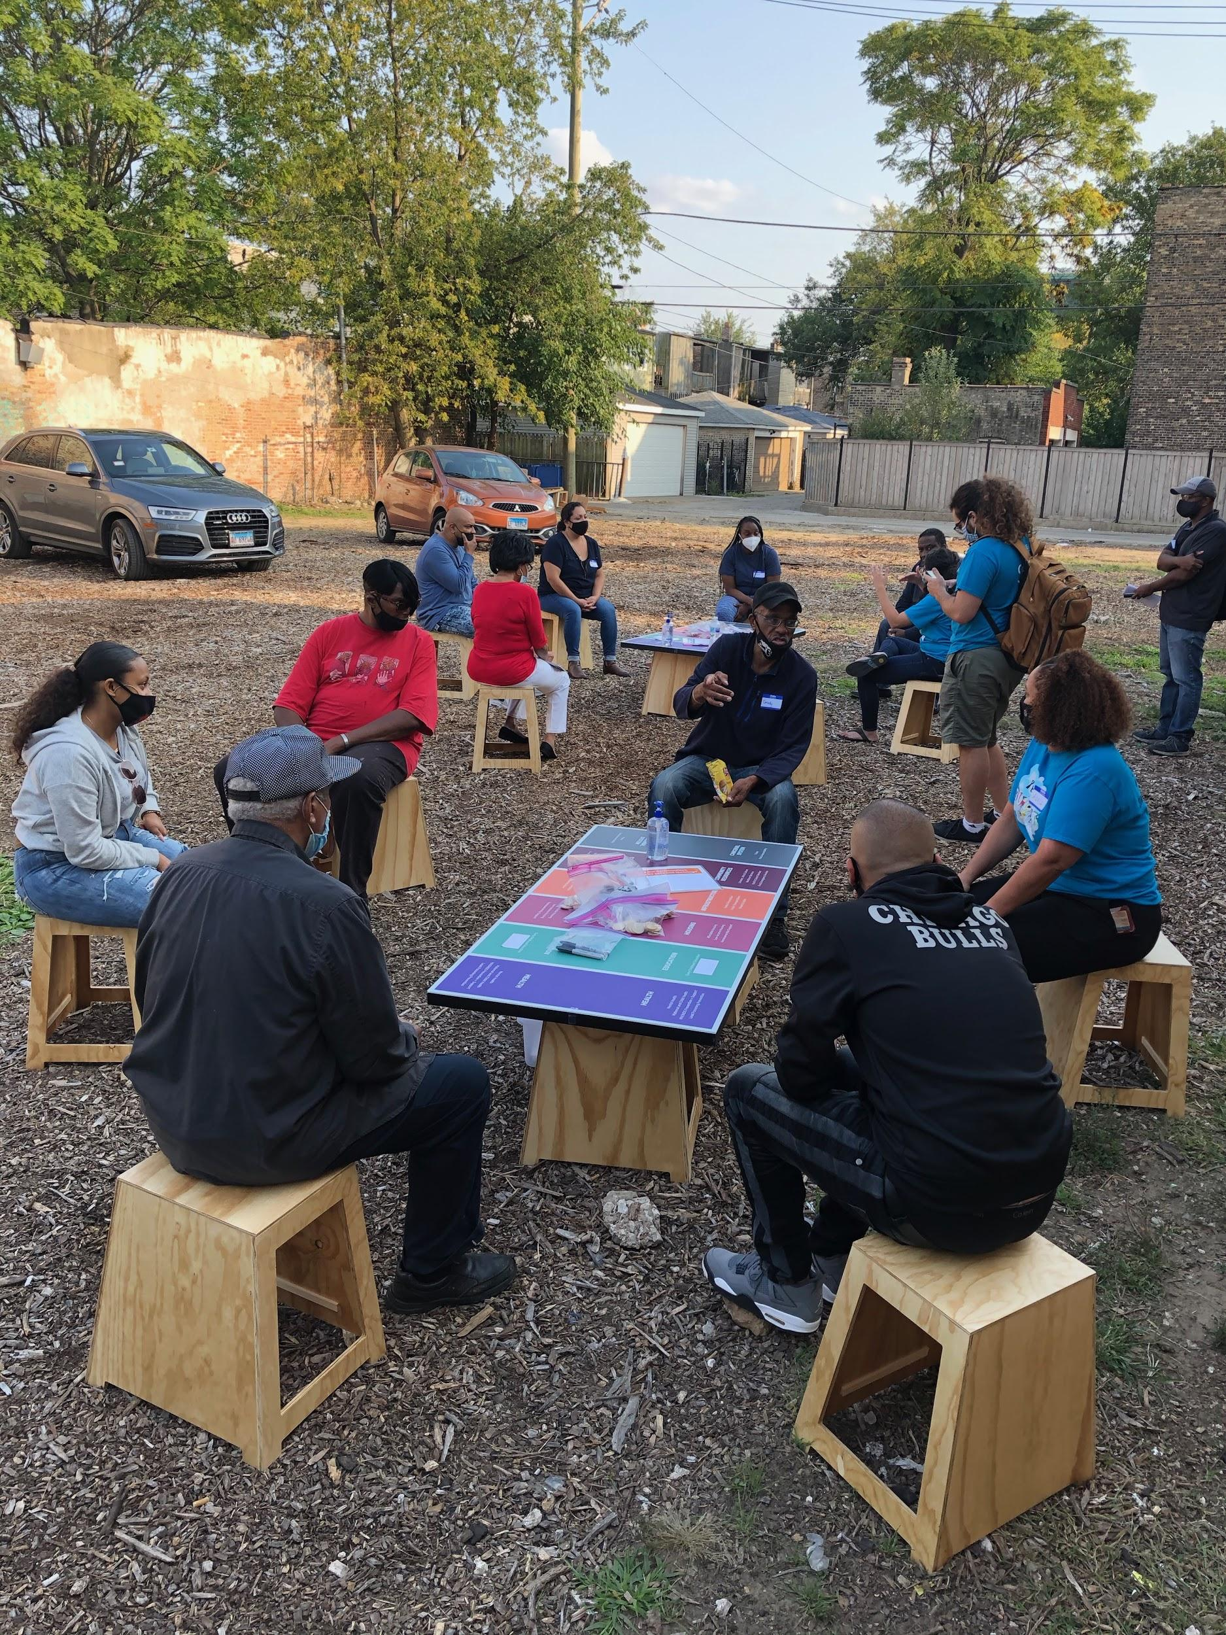
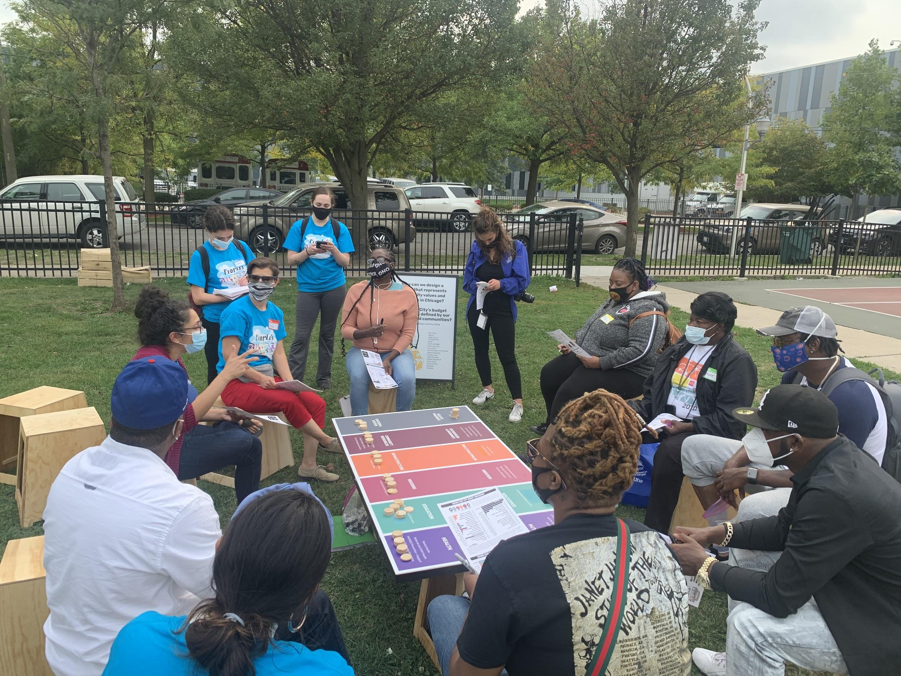
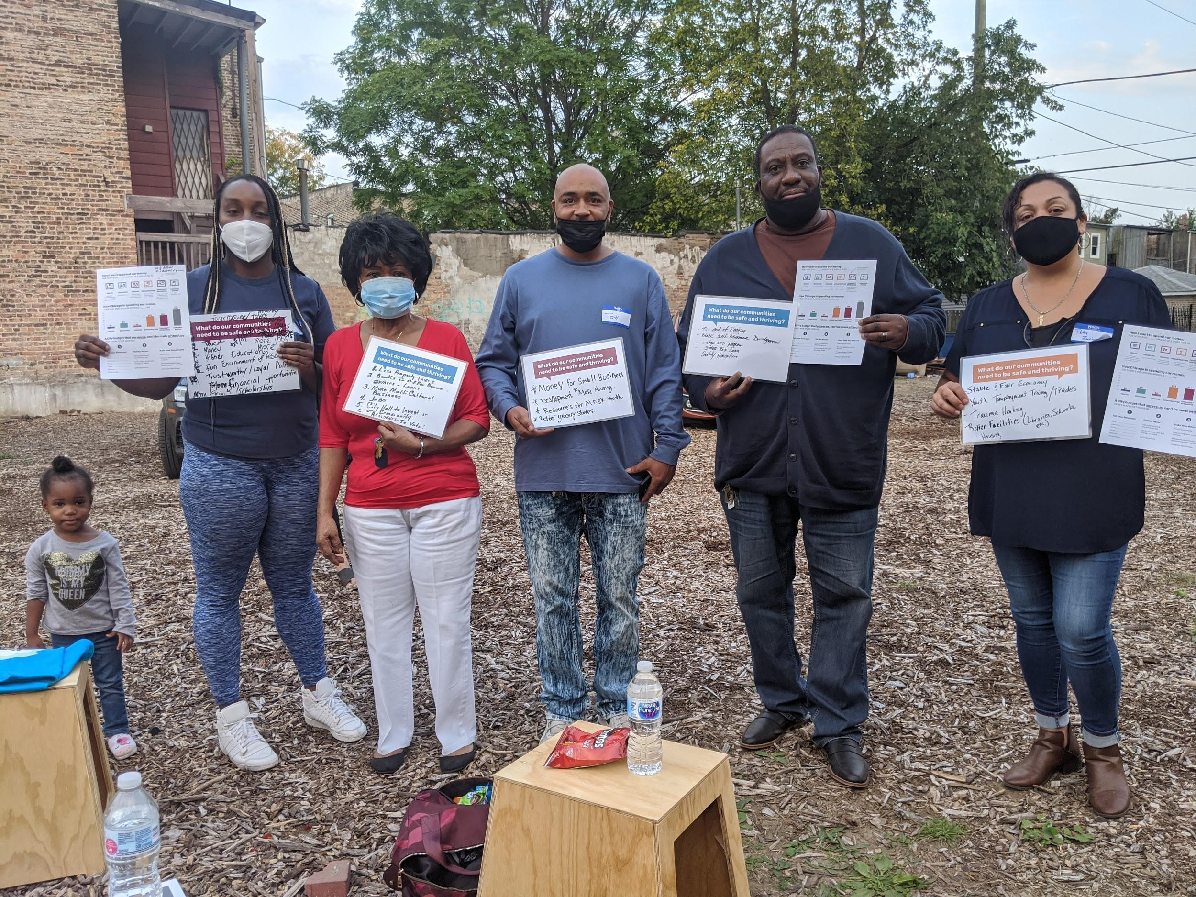
How was the People’s Budget Chicago built?

Slide 24
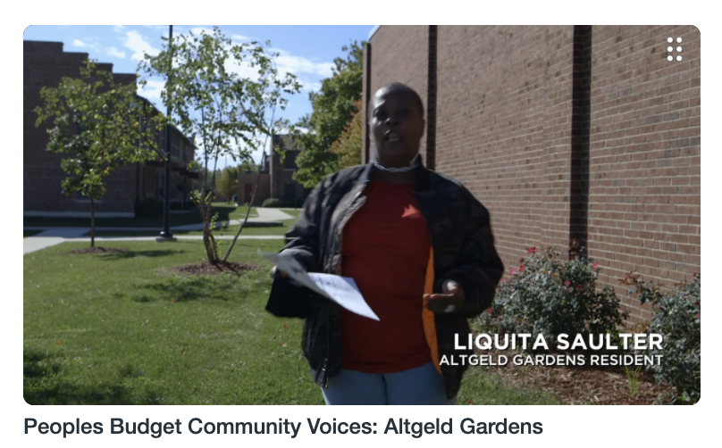
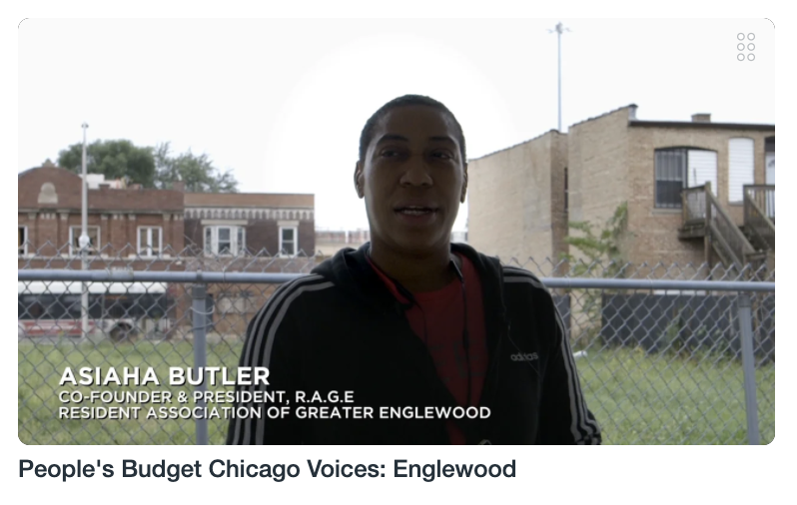
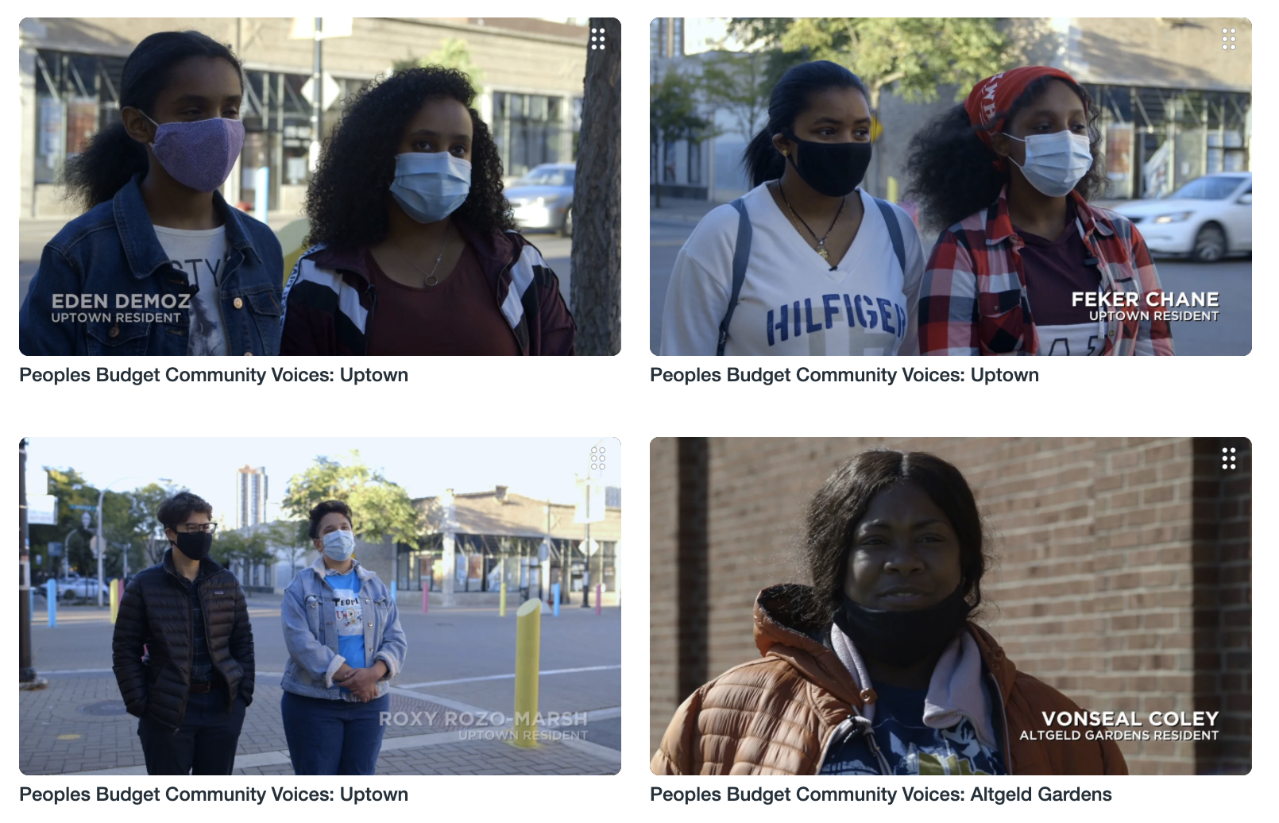
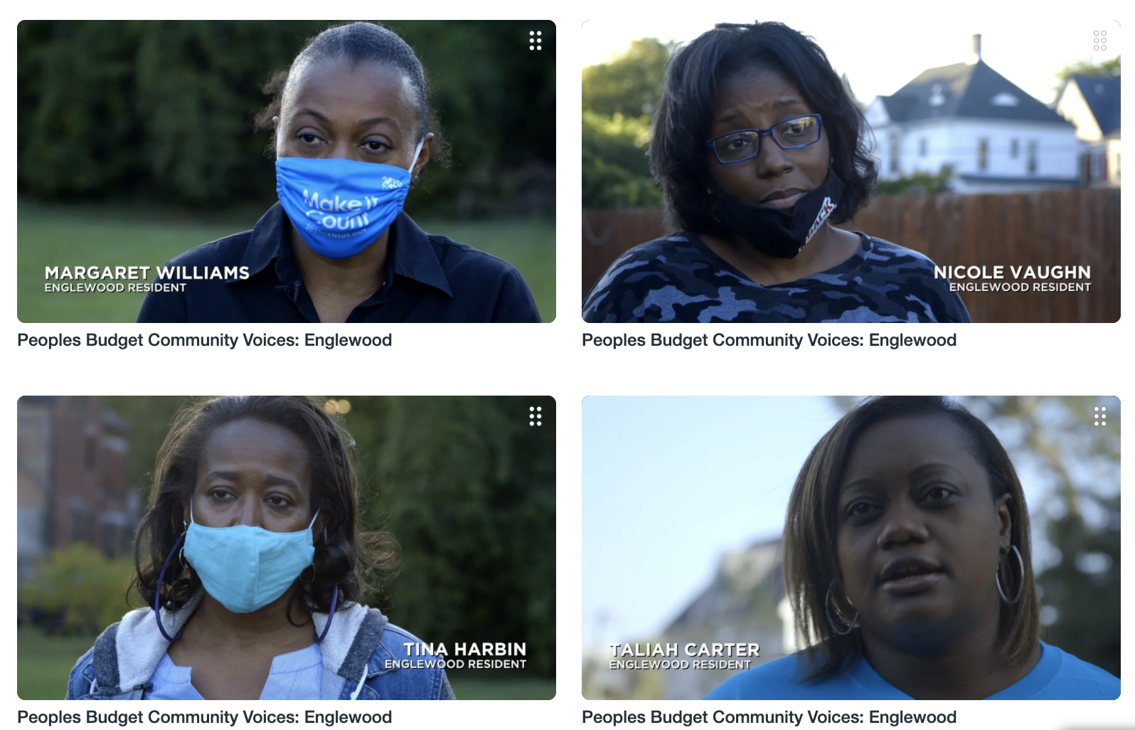
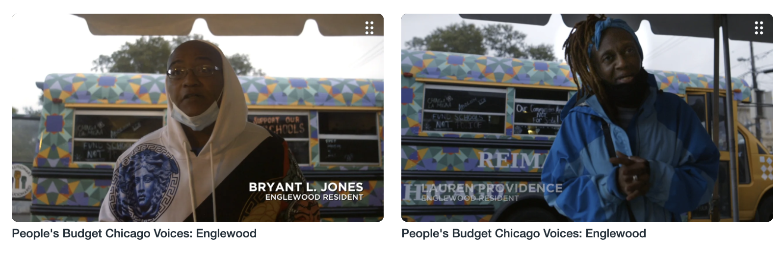
The People who built the People’s Budget Chicago

Slide 25
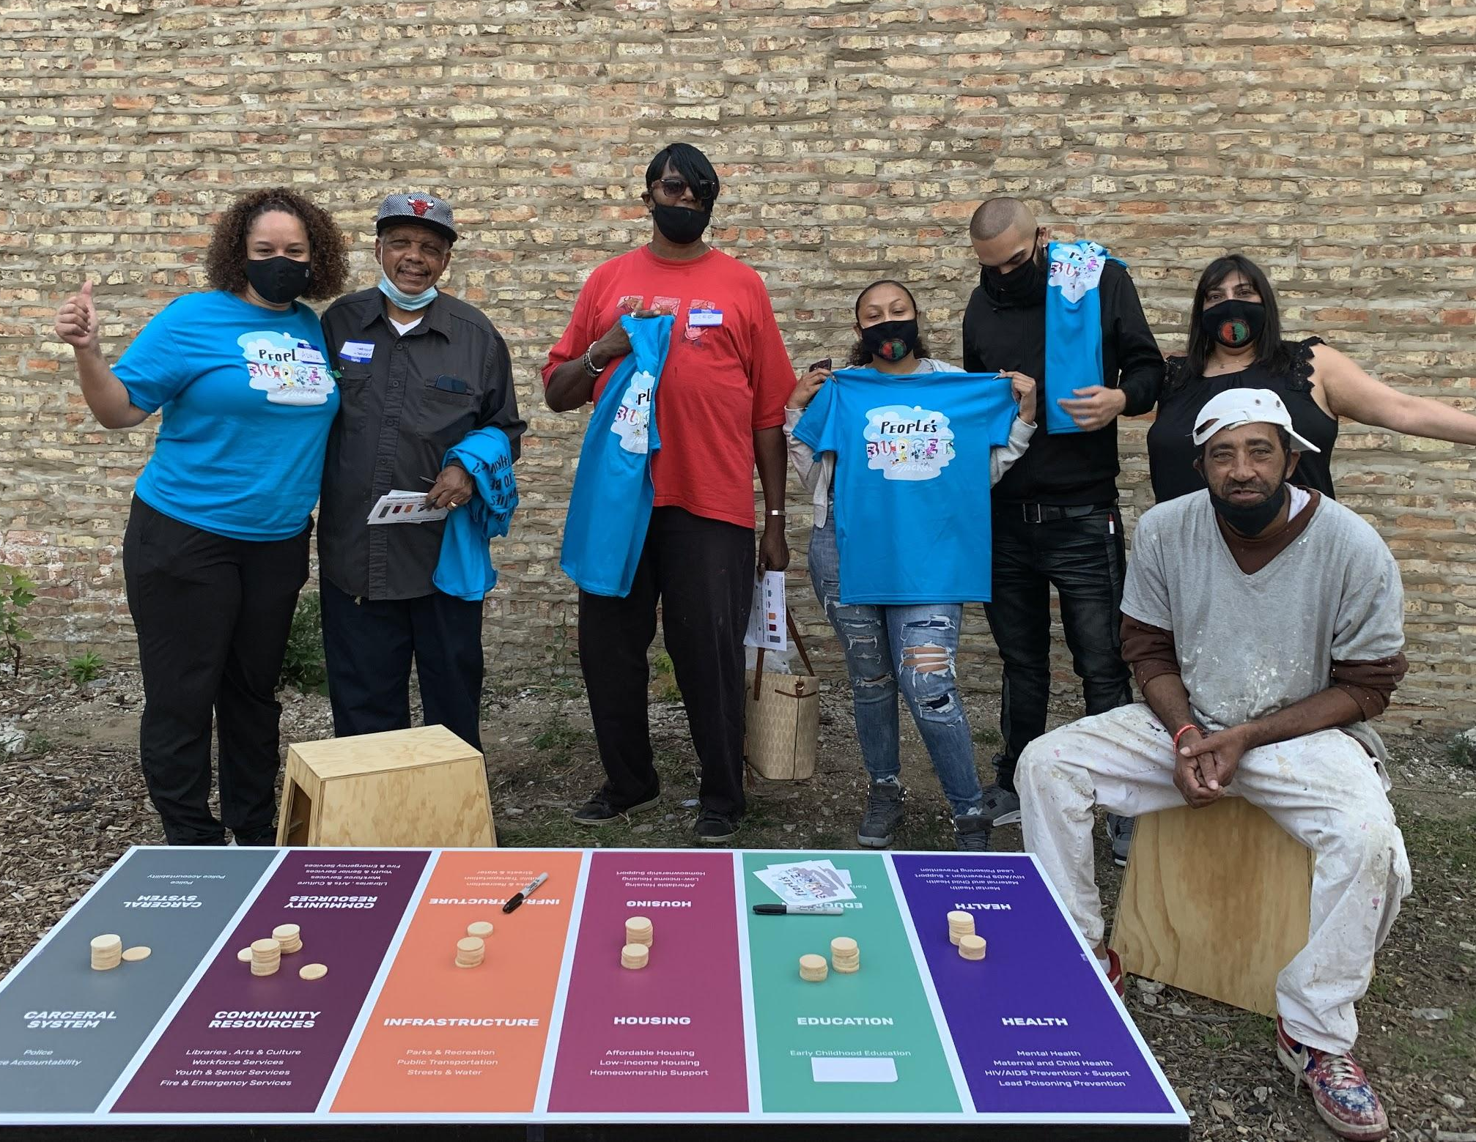
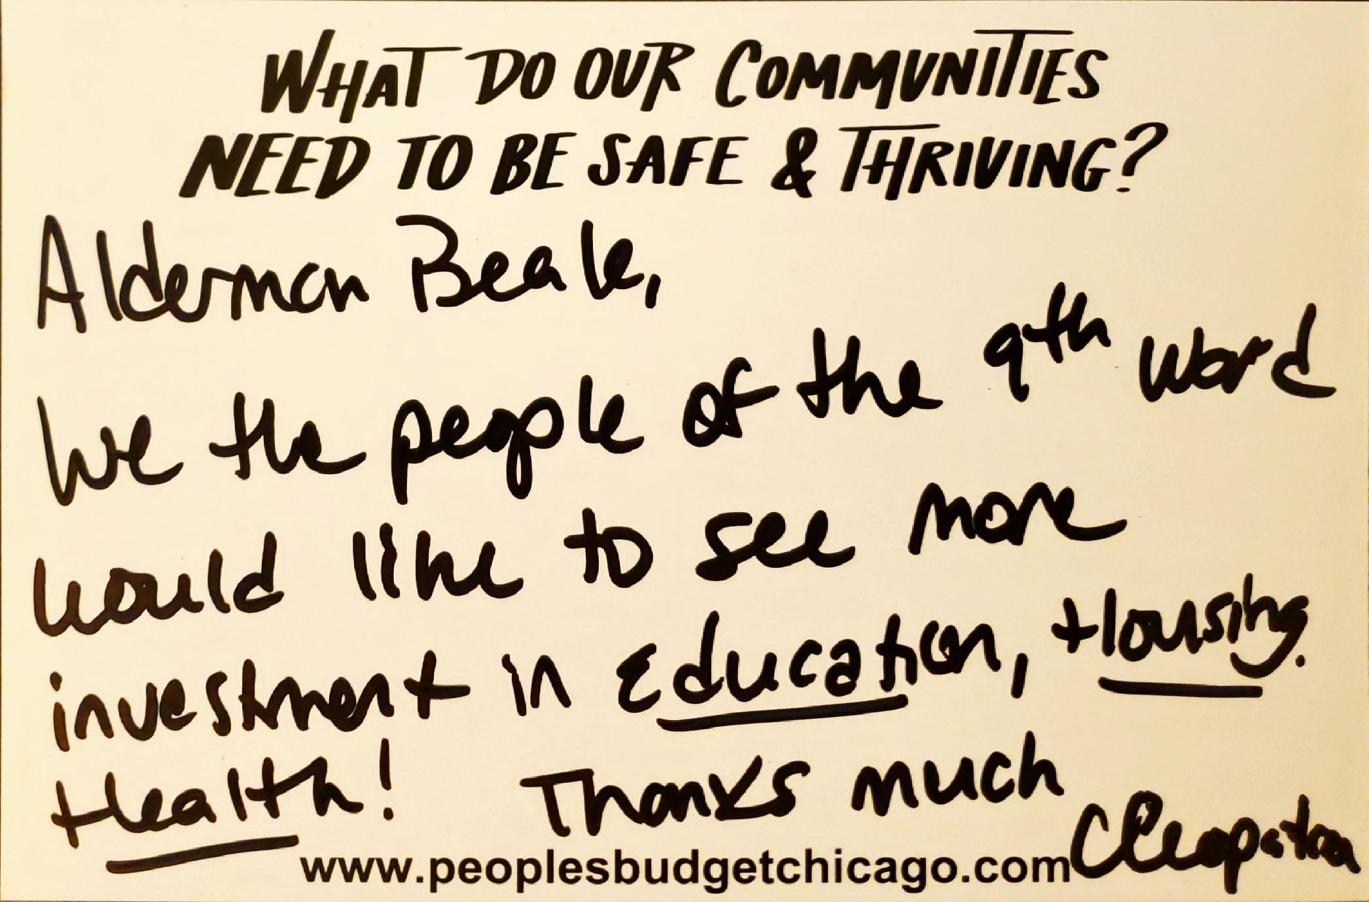
Budget Reps & Accountability

Slide 26
Learn more at:
www.PeoplesBudgetChicago.com
Take action:
bit.ly/PeoplesBudgetAction

